Slide 1
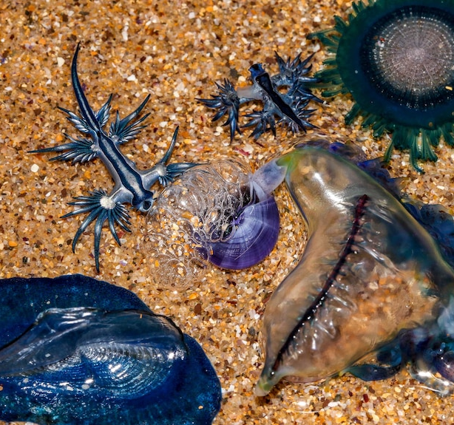
Predators, Prey and Strandings
An IBM approach to modelling the Blue Fleet
Joop Sassen

Slide 2
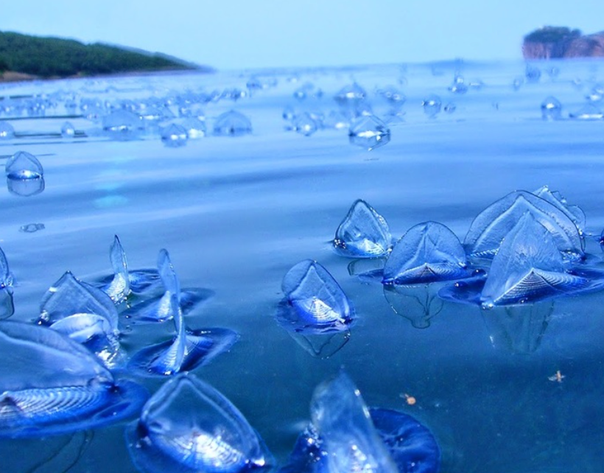
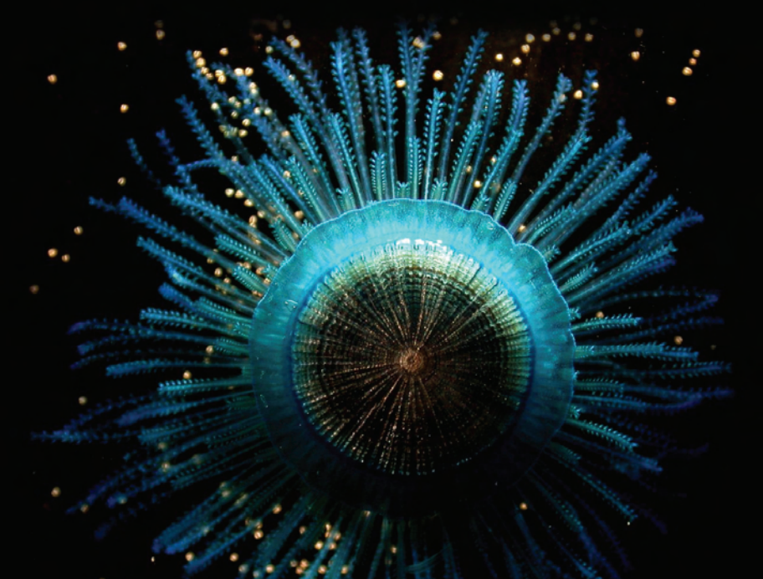
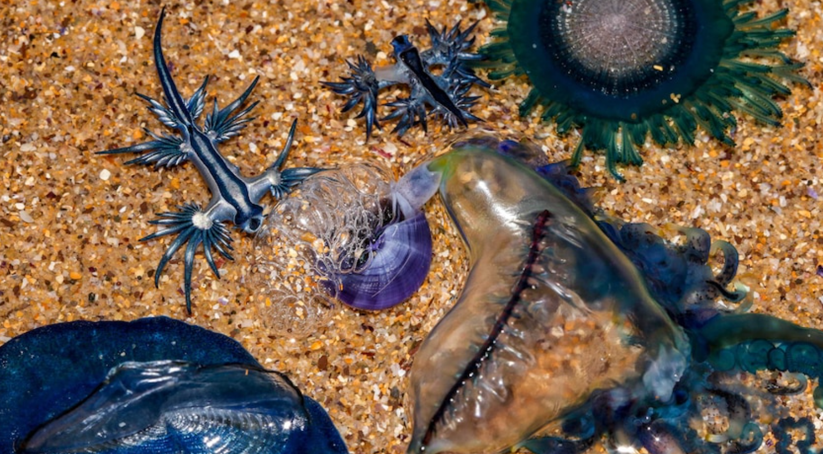
Drifting in the wind AND CURRENTS
Life at the surface – The Blue Fleet and the Neuston

Slide 3
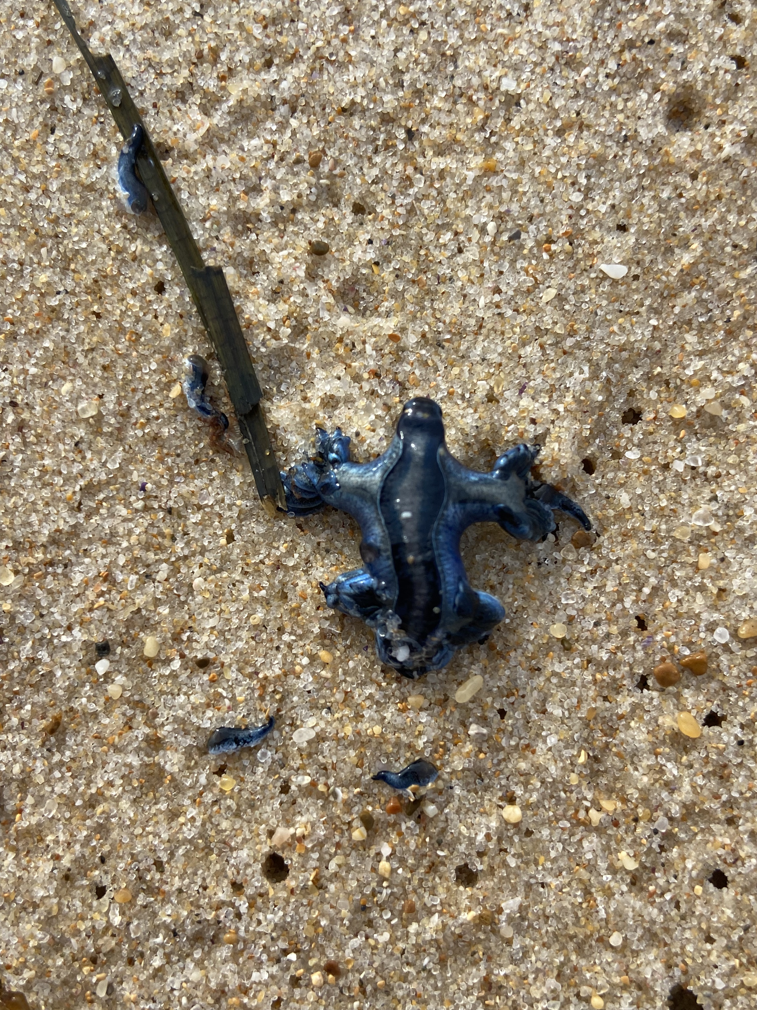
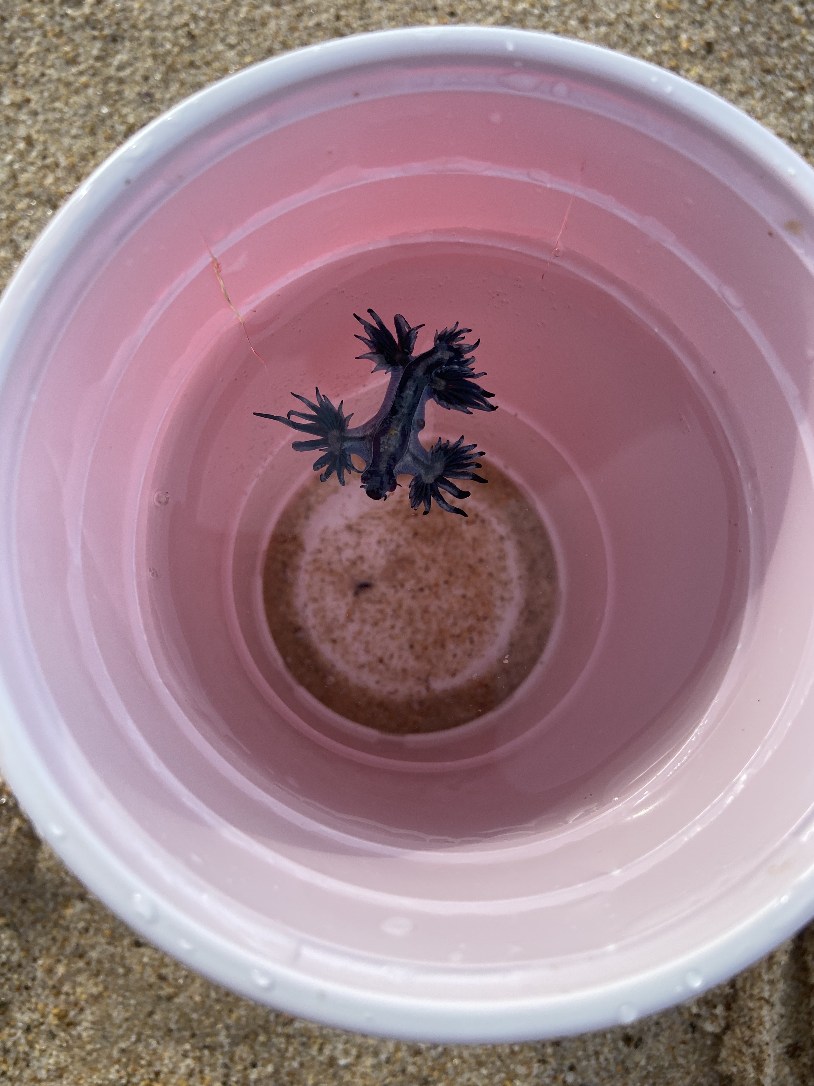
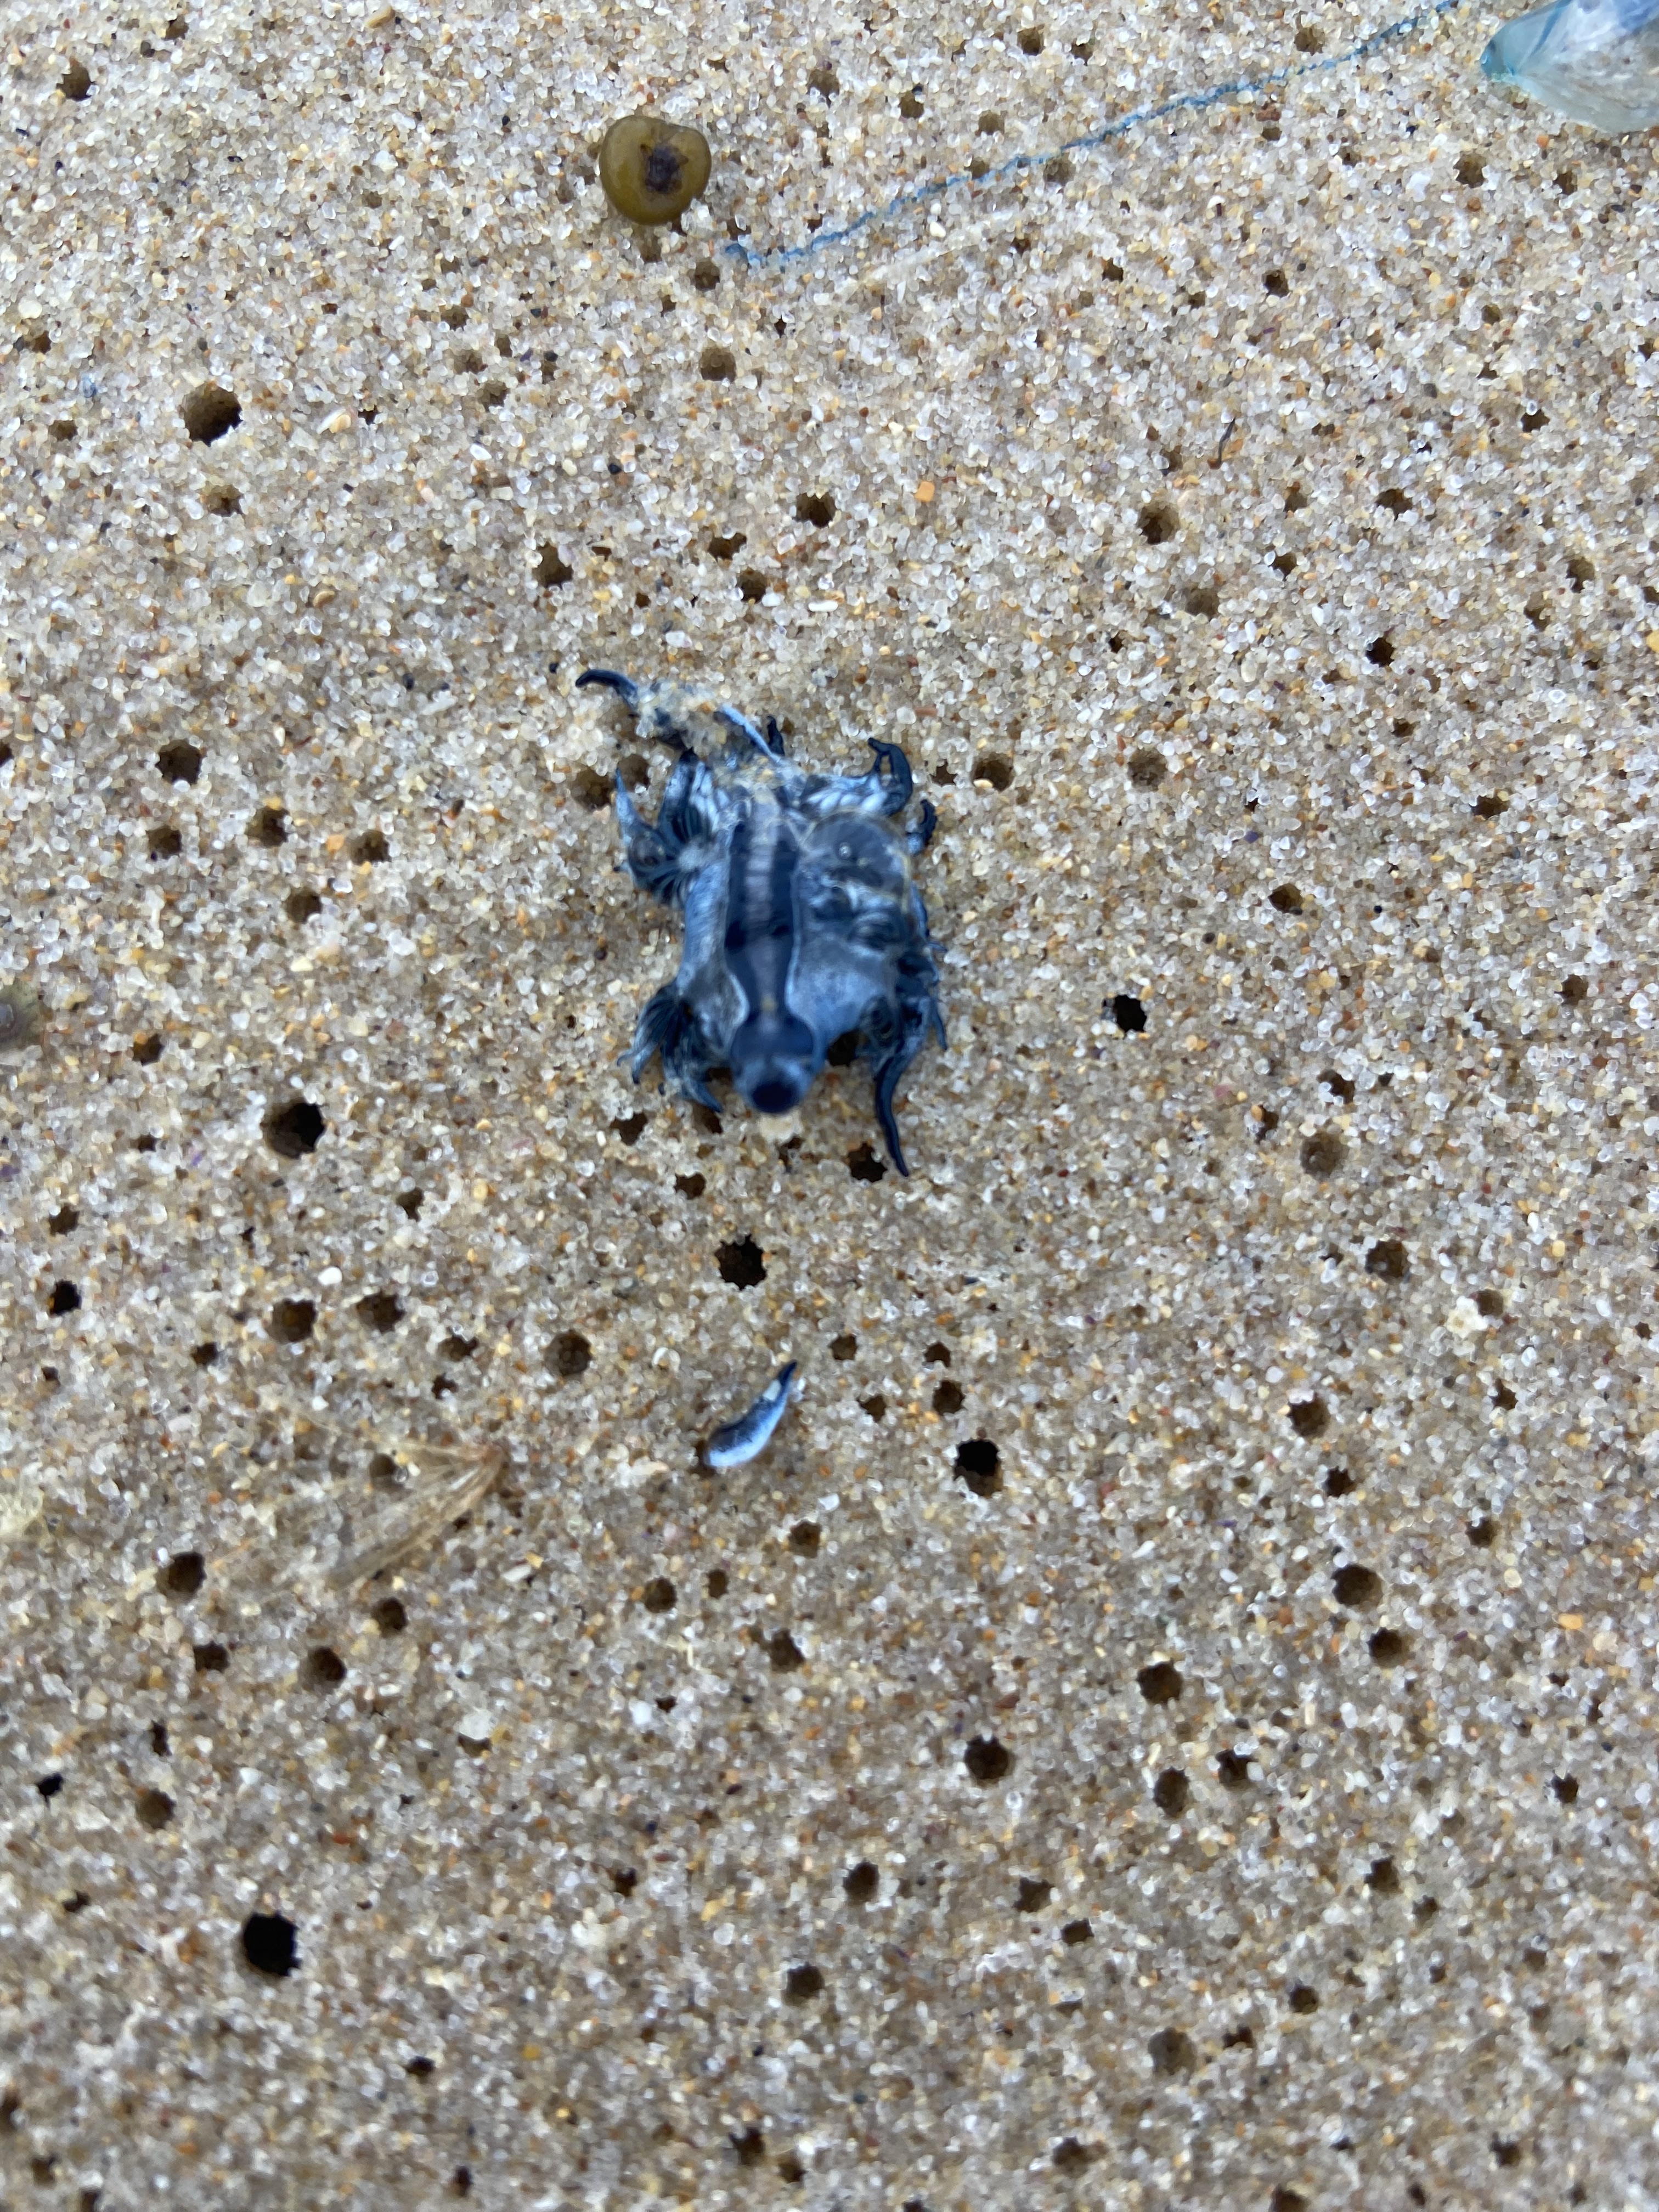
A THOUGHT-PROVOKING find
Why do some species wash up in isolation?
How does a poor swimmer find prey on the open ocean?

Slide 4
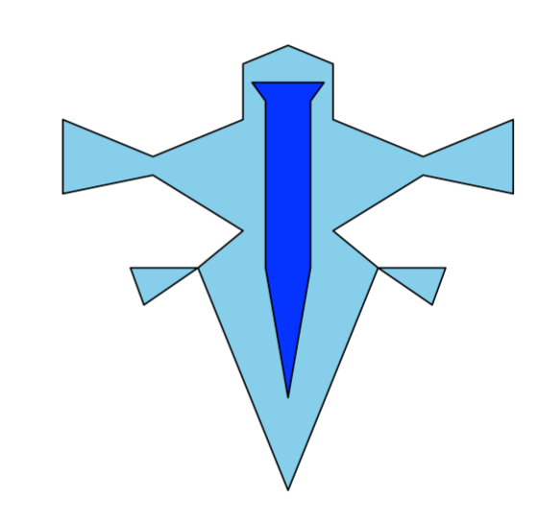
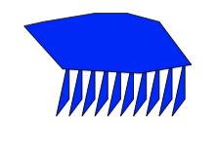
Building the model: the agents
Glaucus atlanticus
The ‘Blue Dragon’
Physalia physalis
Bluebottle

Slide 5
Building the model
Explain model in three core steps:
Movement (gif)
Hunting (gif)
Interaction of ecology and movement (gif)
Overall dynamic (gif of 1 simulation)
Maybe a vector field (static)

Slide 6
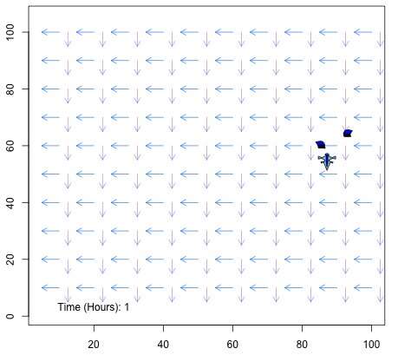
Physically-driven movement
Movement is a function of speed and direction of wind and currents.
Bluebottles come in two forms – impacts where wind takes them.
Different species move differently due to varying morphologies

Slide 7
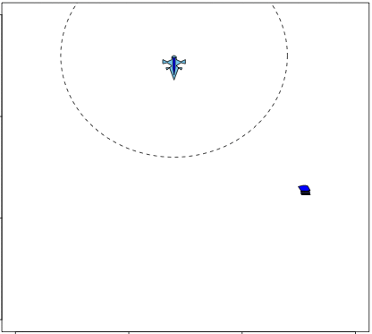
BEHAVIOURAL-driven movement
Glaucus are predators.
Thought to be capable of some powered movement and chemodetection of prey.
Biological parameters and behaviour are poorly studied.

Slide 8
Simulating the blue fleet
2-3 Figures of different model parameter values interesting for main results

Slide 9
MaiN RESULTS

Slide 10
Concluding statements
The Blue Fleet: A loose assemblage or tightly woven web?
Looser than you think! Stranding probabilities are very different …
Do Glaucus even need to move?
Probably not. When prey density exceeds xxx, there is little added value from movement or chemodetection.

Slide 11
rEFERENCES

